Slide 1
HIS 103:Emergence of Bangladesh
The United Front Elections in 1954
&
Bangabandhu
March 14, 2022

Slide 2
The Election of the United Front in 1954
Background of the Formation of the United Front:
The general election in East Bengal was supposed to be held in 1951. However, in a by-election held in Tangail in 1949, the candidate of the Muslim League was defeated. This unexpected defeat proved the Muslim League’s unpopularity and indifference to serve the cause of East Bengal.
Chief Minister Nurul Amin realized that Muslim League had lost the grass root support and, thus, did not want to risk further setback. As a result, the duration of the Provincial Legislature was unduly extended by the Central Legislature.
Delaying the general elections under various pretexts only confirmed the organizational weakness of the Muslim League.
The Muslim League also denied the democratic rights of the people of East Pakistan to choose their own representatives, and failed to respond to the challenge offered by the partition.
The Muslim League as a political organization became a monolithic, virtually detached from the common people.

Slide 3
The Election of the United Front in 1954
Background (cont.):
As the Muslim League was no longer supporting the cause of East Bengal and its people, new political parties dedicated to the cause of the common people in general, and East Bengal in particular, emerged.
Consequently, the Muslim League became incapable of holding on those elements who joined the League in order to achieve the common goal— Pakistan. This let us witness the gradual disintegration of the Muslim League and formation of new parties at its expense.
Furthermore, the issues of the state language and political autonomy led to the formation of regional parties, such as the Awami Muslim League (1949) and the Krishak Sramik Party (1953) etc.

Slide 4
The Election of the United Front in 1954
Therefore, the new opposition parties emerged were as follows:
Awami Muslim League was formed in 1949
Pakistan Democratic Party was formed in January 1953
Nezam-E-Islam (1953) by Maulana Atahar Ali
Fazlul Huq revived his Krishak Praja Party (1937) under the new name Krishak Sramik Party on 23 August 1953.
Ganatantri Dal by Hazi Mohammad Danesh (Dinajpur) in January 1953
In 1954 Abul Hashim formed the Khilafate Rabbany Party
All these parties were formed to create a healthy democratic opposition

Slide 5
The Election of the United Front in 1954
The United Front in the Making:
On 14 November 1953 at a historic council of the East Pakistan Awami Muslim League held at Mymensingh the decision of forming a United Front was taken.
(Bangabandhu) Sheikh Mujibur Rahman in his General Secretary’s Report declared that East Bengal had lost its faith in Muslim League and it is now united to refuse the League from the Province. However, initially he did not support the formation of the United Front, nor did Moulana Bhasani.
Students are strongly recommended to go through pages 247 through 280 of the Unfinished Memoirs (English Version) of Bangabandhu for a detailed account of the United Front formation, nominations, campaigns, election results, cabinet formation, dismissal of the United Front Cabinet etc. For Bengali, please see pages 243-277.
United Front Coalition – Awami League, the Krishak Sramic Party, the Nizam-e-Islam (1953) and Ganatantri Dal.
Leading roles played by AK Fazlul Huq, HS Suhrawardy and Maulana Abdul Hamid Khan Bhasani. Among the young leaders Sheikh Mujib played a vital role.

Slide 6
The Election of the United Front in 1954
Election Campaign: United Front and Muslim League
The symbol of the United Front was Boat
The Election manifesto launched by the United Front included 21 Points. The two main points were autonomy for East Bengal (defense, foreign policy and currency were excluded) and the recognition of Bangla as one of the State Languages of Pakistan.
The establishment of Bangla Academy and Declaration of 21 February as a public holiday were the two other important points.
Student leaders played crucial role. The United Front galvanized the Bengalis to press for their legitimate demands on all aspects.
The famous 21 Points were delivered by Maulana Bhashani while it was drafted by Abul Mansur Ahmed and was finalized by H. S. Suhrawardy.
United Front achieved the spontaneous support and popularity of the people of East Pakistan due to the high esteem of Fazlul Huq, Suhrawardy and Maulana Bhashani in their mind.

Slide 7
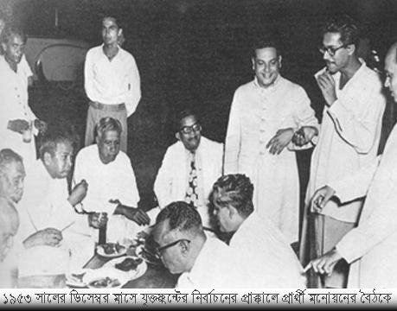
Nomination at the United Front Elections, 1953

Slide 8
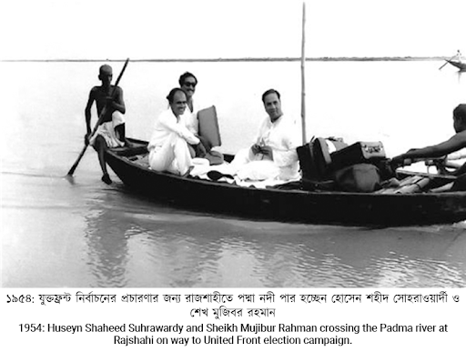
Election Campaigns, 1954

Slide 9
The Election of the United Front in 1954
Election Campaign (Cont.):
Muslim League also tried its best to win over the people of East Bengal by adopting some very provocative and communal postures.
The League warned that voting against it would be equivalent to supporting the enemies of Pakistan.
Some of the West Pakistan based newspapers also supported the League raising religious and regional issues.
The League was supported by West Pakistan based industrialists, landlords and business people.
The election strategy of the United Front was to hammer upon the failure of the Muslim League administration in various fields specially on the language issue, economic mismanagement and food crisis. In this connection, they mentioned the negative roles played by Kwaja Nazimuddin and Nurul Amin.
United Front’s vigorous election campaign was conducted by various factions of the FRONT who were more aggressive, persuasive and enthusiastic.
Front’s campaigning on the autonomy and language issue had great impact upon the voters.

Slide 10
The Election of the United Front in 1954
21-Point Program of the United Front:
To recognise Bangla as one of the State Languages of Pakistan;
To abolish without compensation zamindari and all rent receiving interest in land, and to distribute the surplus lands amongst the cultivators; to reduce rent to a fair level and abolish the certificate system of realising rent;
To nationalise the jute trade and bring it under the direct control of the government of East Bengal, secure fair price of jute to the growers and to investigate into the jute-bungling during the Muslim League regime to punish those found responsible for it;
To introduce co-operative farming in agriculture and to develop cottage industries with full government subsidies;
To start salt industry (both small and large scale) to make East Bengal self-sufficient in the supply of salt, and to investigate into the salt-bungling during the Muslim League regime to punish the offenders;
To rehabilitate immediately all the poor refugees belonging to the artisan and technician class;
To protect the country from flood and famine by means of digging canals and improving irrigation system;
To make the country self-sufficient by modernising the method of cultivation and industrialisation, and to ensure the rights of the labourer as per ILO Convention;
To introduce free and compulsory primary education throughout the country and to arrange for just pay and allowances to the teachers;
To restructure the entire education system, introduce mother tongue as the medium of instruction, remove discrimination between government and private schools and to turn all the schools into government aided institutions;
To repeal all reactionary laws including those of the Dhaka and Rajshahi Universities and to make them autonomous institutions; to make education cheaper and easily available to the people;

Slide 11
The Election of the United Front in 1954
21-Point Program (Cont.):
To curtail the cost of administration and to rationalise the pay scale of high and low paid government servants. The ministers shall not receive more than 1000 taka as monthly salary;
To take steps to eradicate corruption, nepotism and bribery, and with this end in view, to take stocks of the properties of all government officers and businessmen from 1940 onward and forfeit all properties the acquisition of which is not satisfactorily accounted for;
To repeal all Safety and Preventive Detention Acts and release all prisoners detained without trial, and try in open court persons involved in anti-state activities; to safeguard the rights of the press and of holding meetings;
To separate the judiciary from the executive;
To locate the residence of the chief minister of the United Front at a less costly house, and to convert Burdwan House into a students hostel now, and later, into an institute for research on Bangla language and literature;
To erect a monument in memory of the martyrs of the Language Movement on the spot where they were shot dead, and to pay compensation to the families of the martyrs;
To declare 21 February as ‘Shaheed Day’ and a public holy day;
The Lahore Resolution proposed full autonomy of East Bengal leaving defence, foreign affairs and currency under the central government. In the matter of defence, arrangements shall be made to set the headquarters of the army in West Pakistan and the naval headquarters in East Bengal and to establish ordnance factories in East Bengal, and to transform Ansar force into a full-fledged militia equipped with arms;
The United Front Ministry shall on no account extend the tenure of the Legislature and shall resign six months before the general elections to facilitate free and fair elections under an Election Commission;
All casual vacancies in the Legislature shall be filled up through by-elections within three months of the vacancies, and if the nominees of the Front are defeated in three successive by-elections, ministry shall resign from office.

Slide 12
The Election of the United Front in 1954
The Much-awaited Election and its Results:
1954 Election was held on 8-12 March 1954 under the India Act of 1935, and on the basis of universal adult franchise.
Separate Electorate for different ethnic minorities.
By amending the Fifth and Sixth Schedules to the Government of India Act , 1935, the total number of seats in the East Pakistan Provincial Assembly was fixed at 309.
Distribution of seats– 237 Muslim Seats, 31 General Seats for Hindus other than from scheduled castes, 1 seat for Pakistan Christians and 2 Seats for Buddhists and 38 for Scheduled caste.
Of the Muslim, General and Scheduled Caste Seats were 9, 1, and 2 seats respectively were exclusively reserved for women of the three communities.
In the election of 1954, the Jukto Front won a landslide victory and the Muslim League was virtually wiped out from the political scene of the country.
The United Front won 223 seats out of 237 Muslim seats whereas the ruling Muslim League managed to win only 9- a big setback indeed!.

Slide 13
The Election of the United Front in 1954
Election Results:
Name of Political Parties | Seats (Muslim) | Name of Political Parties | Seats (Non-Muslim)
AWAMI Muslim LEAGUE | 143 | SCHEDULED CASTE FEDERATION | 27
KRISHAK SRAMIK PARTY | 48 | NATIONAL CONGRESS | 24
NIZAM-E-ISLAM PARTY | 19 | MINORITY UNITED FRONT | 10
GANATANTRI DAL | 13 | COMMUNIST PARTY | 4
MUSLIM LEAGUE | 9 | GANATANTRI DAL | 3
Independent & others | 5 | Independent & others | 4

Slide 14
The Election of the United Front in 1954
Post-Election Developments:
Following the outcome of the elections, the East Bengal Governor Choudhury Khaliquzzaman invited the United Front Leader & Krishak Sramik Party Leader AK Fazlul Huq on 25 March 1954 to form the government. The United Front Ministry was formed on 3 April 1954.
The subsequent developments were however very disappointing for the coalition as they could not deliver the goods for which they were elected. Rather a sad and bitter political disunity took place leading to the unhappy time for the people of East Bengal.
Personality clash and divergent party programs were mainly responsible for the disintegration of the United Front within the shortest period of their formation.
Strictly speaking the United Front was an election time alliance based on anti-Muslim League sentiment, which eventually broke down due to power distribution in the United Front Cabinet.

Slide 15
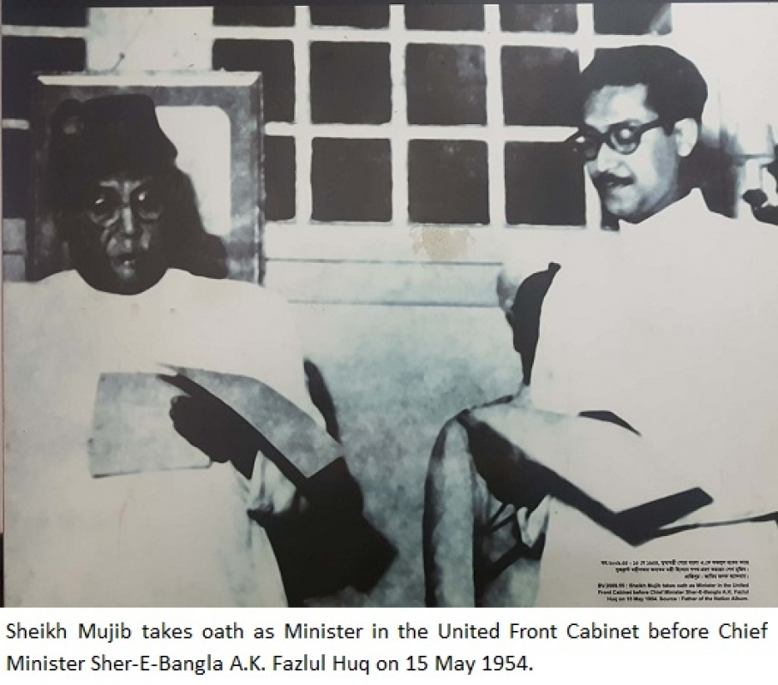
Bangabandhu in the Fazlul Huq Cabinet

Slide 16
The Election of the United Front in 1954
The Short-lived-Fragile United Front (UF) Government:
During his visit to Kolkata in May 1954, Fazlul Huq had made some speeches expressing friendship and closeness with the people of West Bengal.
Fazlul Huq was also reported to have said that ‘ Independence will be the first thing to be taken up by his ministry at the negotiation between the Center and East Bengal’.
This was interpreted by the Pakistani Government as anti-Pakistani and anti-State move and Huq was accused of contemplating the independence of East Bengal.
However, nothing happened for the time being and Huq in order to mend the situation expanded his cabinet on 15 May 1954 where members of the Awami Muslim League were also included.
A serious riot between the Bangali and non-Bengali workers of the Adamjee Jute Mills at Narayanganj, and paper mills at Chittagong caused the death of 1500 workers on the very day of the cabinet expansion that is 15 May.
The riots between Bangalis and Biharis were pre-planned and were engineered by the reactionary elements. The Communist activists were held responsible for the tragedy, and Fazlul Huq government was blamed for its failure in controlling the situation.

Slide 17
The Election of the United Front in 1954
Dismissal of the UF Government:
On May 30, 1954 , the Central Government, instead of taking action against the criminals dismissed the Fazlul Huq Ministry and imposed central rule.
Major General Iskander Mirza, the Defense Secretary was appointed as the Governor of East Bengal.
The politicians of East Bengal missed an opportunity to improve the lot of the Bengalis and of East Bengal due to their own weaknesses and limitations.

Slide 18
The Election of the United Front in 1954
Significance of the UF Elections:
The 1954 general election to the East Bengal Legislative Assembly was important in the political history of erstwhile Pakistan for several reasons:
Firstly, it was the first ever free & fair election held in East Pakistan, now Bangladesh, on the basis of universal adult franchise.
Secondly, it gave expression to the grievances felt by the people of East Pakistan and increased political consciousness and unprecedented enthusiasm among the people of East Pakistan.
Thirdly, it demonstrated strong support of the people of East Pakistan for full regional autonomy.
Fourthly, the election of 1954 paved the way for developing non-communal politics in East Pakistan.
Fifthly, the victory of the United Front in the 1954 election proved to be the victory of Bengali nationalism. Henceforth Bengali nationalism became stronger, popular and got political recognition.
Sixthly, beginning of the ‘politics of alliance, sometimes unholy alliances !
Last but not the least, it marked the denial of the political monopoly of the reactionary Muslim League regime. Indeed, the Muslim League suffered a serious setback in that election, from which it could never fully recover.

